Slide 1



Balhambar Boats
Factory

Slide 2
INTRODUCTION
Balhambar Boats is a renowned boat manufacturer and well-respected name within the industry we follow five simple rules: Our clients come first; we keep our commitments; we are creative, detail oriented and quality conscious; we seek positive solutions; and we enjoy what we do. We offer fantastic and competitive price, Balhambar Boats are happy to make your dreams come true!

Slide 3
Mission
Vision
Fueled by our passion for water and our customers, boating experience, we provide the most reliable and spontaneous thrust and our committed to the best partner to our customers and steak holders.
Delighting customers by providing the best engine and propulsion solutions for world’s most demanding environments.

Slide 4

Core Values
Integrity – We will conduct ourselves at the highest level of ethical standards. We do what we say, and we keep our commitments.
Customer Centricity – We listen to customers and provide them with high-quality product and services.

Slide 5
Balhambar Products
20 feet Catamaran Boat
23 feet Sports Boat
27 feet Boat
29 feet Boat
33 feet Boat
36 feet Boat
38 feet Signature Boat
42 feet Manta Boat
46 feet Boat
48 feet Boat

Slide 6
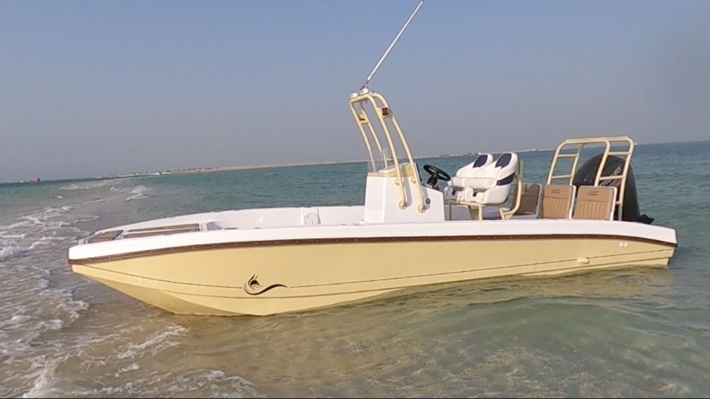
20 Feet Catamaran Boat Details
➢ Length : 20 feet
➢ Beam : 8.0 feet
➢ Draft : 1.5 feet
➢ Dry Weight : 600 kgs
➢ Fuel Tank Capacity : 180 ltrs.
➢ Seating Capacity : 5 persons

Slide 7
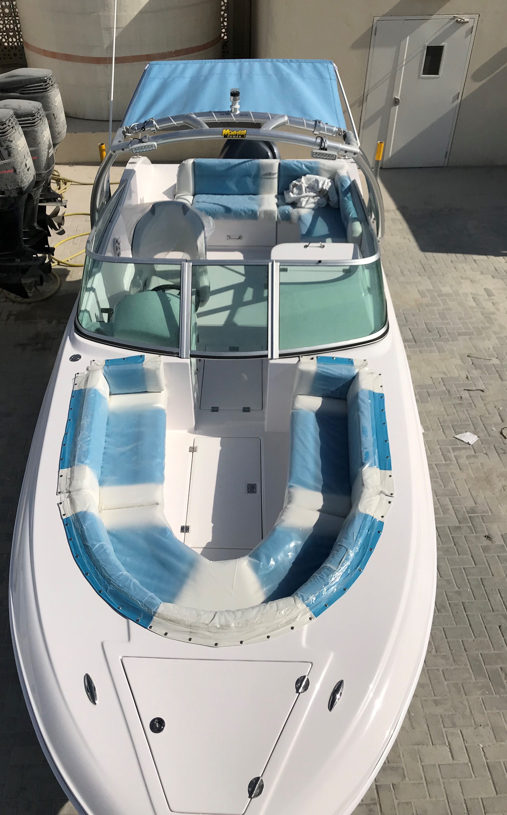
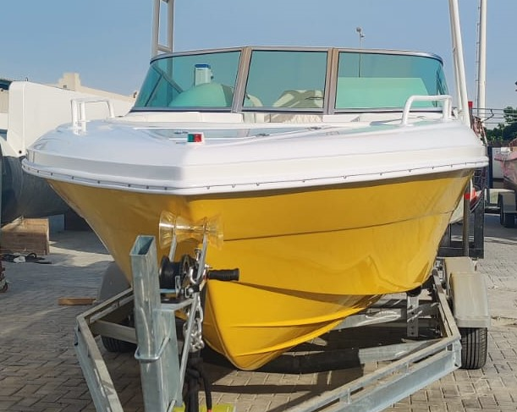
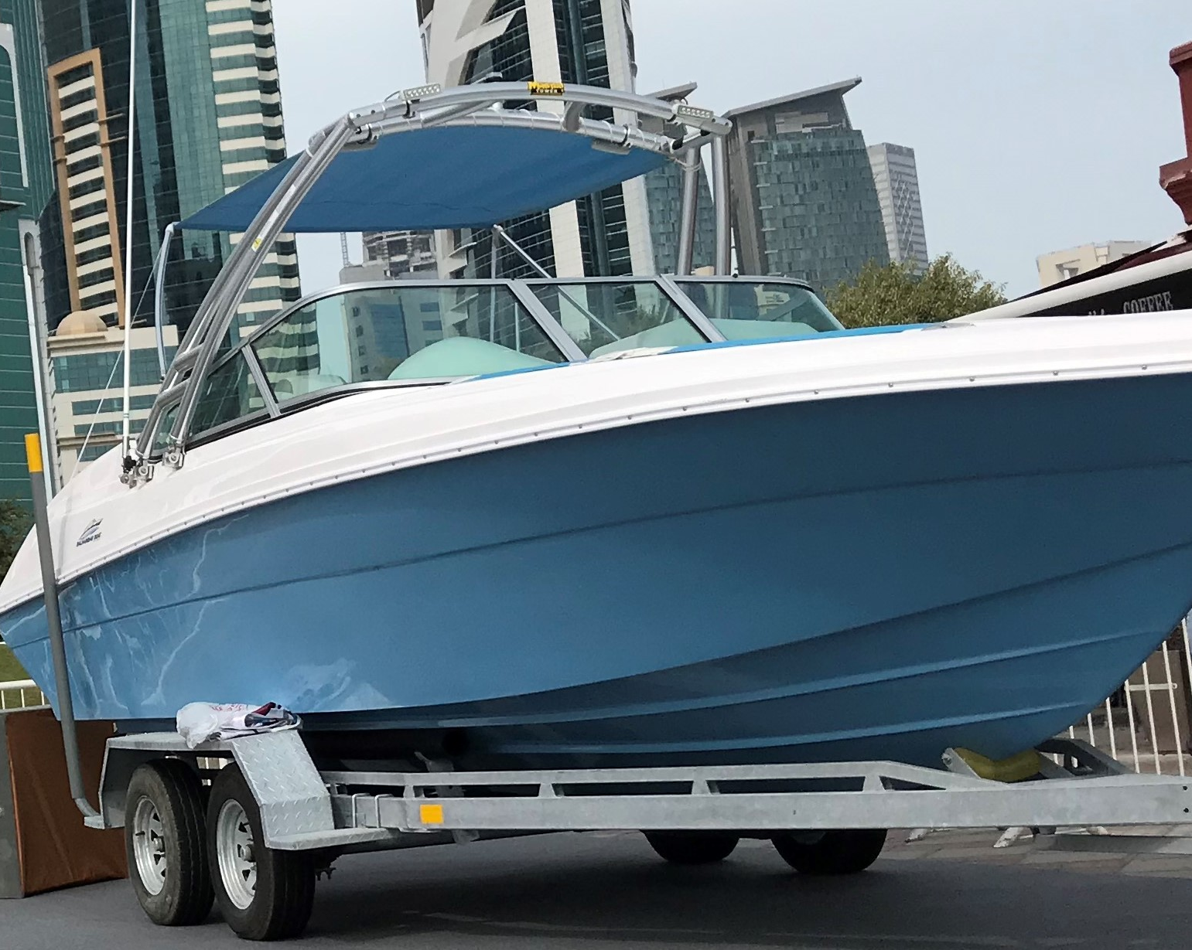
23 Feet Sports Boat Details
➢ Length : 23 feet
➢ Beam : 7.11 feet
➢ Draft : 2.0 feet
➢ Dry Weight : 800 kgs
➢ Fuel Tank Capacity : 300 ltrs.
➢ Water Tank Capacity : 100 ltrs.
➢ Seating Capacity : 8 persons

Slide 8
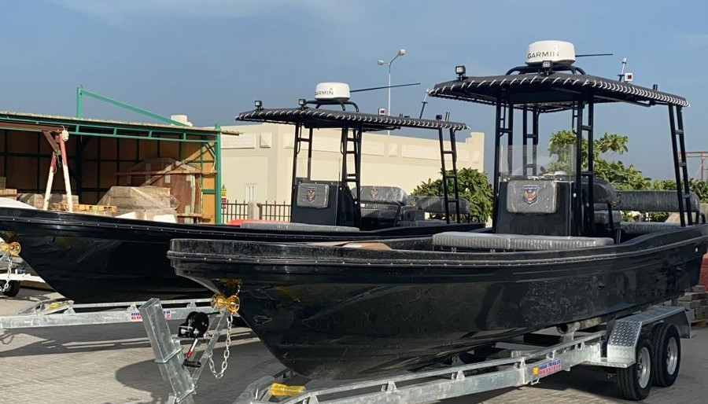
27 Feet Boat Details
➢ Length : 27 feet
➢ Beam : 6.74 feet
➢ Draft : 1.9 feet
➢ Dry Weight : 850 kgs
➢ Fuel Tank Capacity : 400 ltrs.
➢ Water Tank Capacity : 100 ltrs.
➢ Seating Capacity : 7 persons

Slide 9
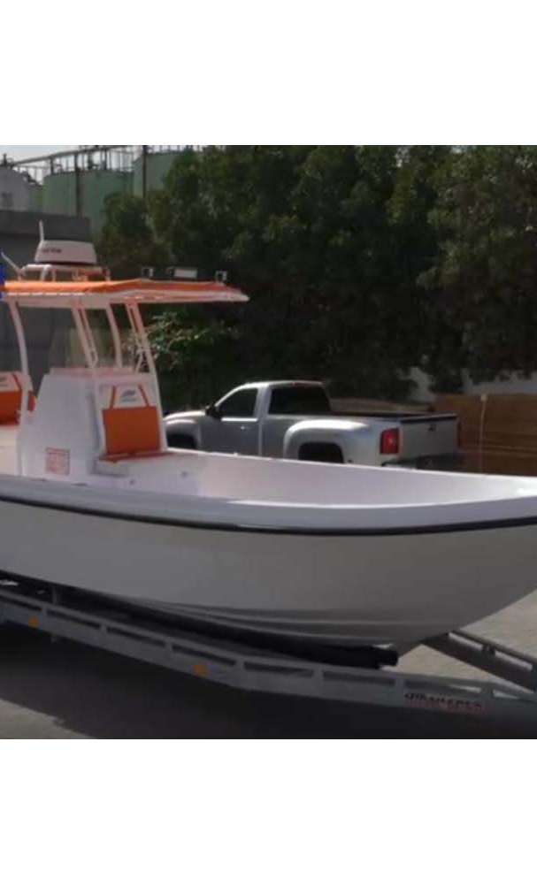
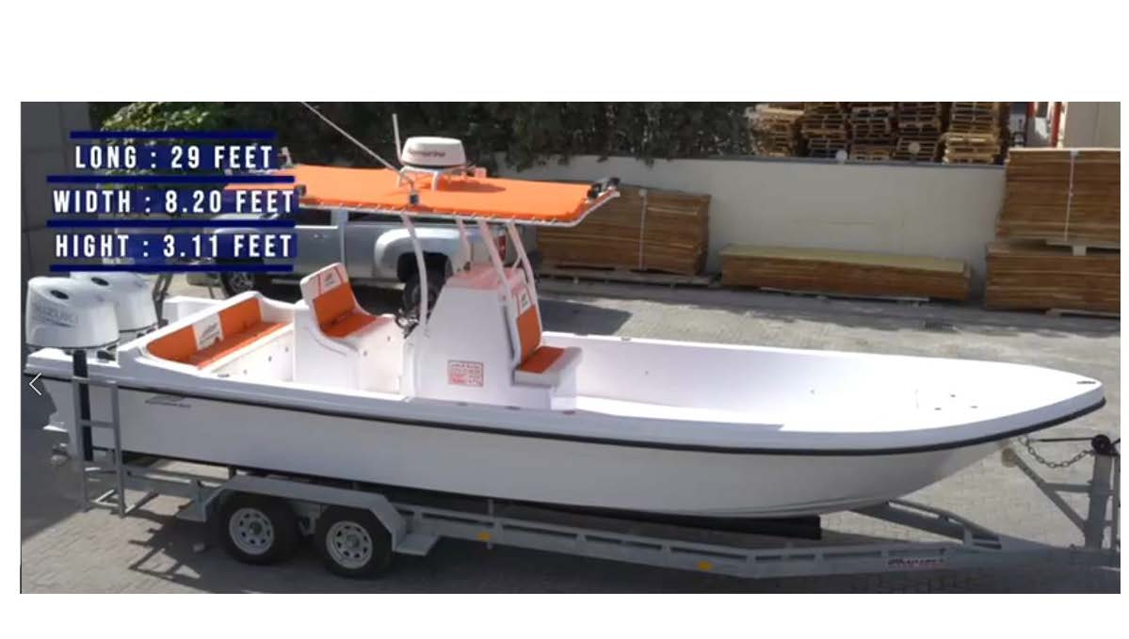
29 Feet Boat Details
➢ Length : 29 feet
➢ Beam : 8.20 feet
➢ Draft : 2.5 feet
➢ Dry Weight : 1100 kgs
➢ Fuel Tank Capacity : 600 ltr.
➢ Water Tank Capacity : 100 ltr.
➢ Seating Capacity : 7 persons

Slide 10
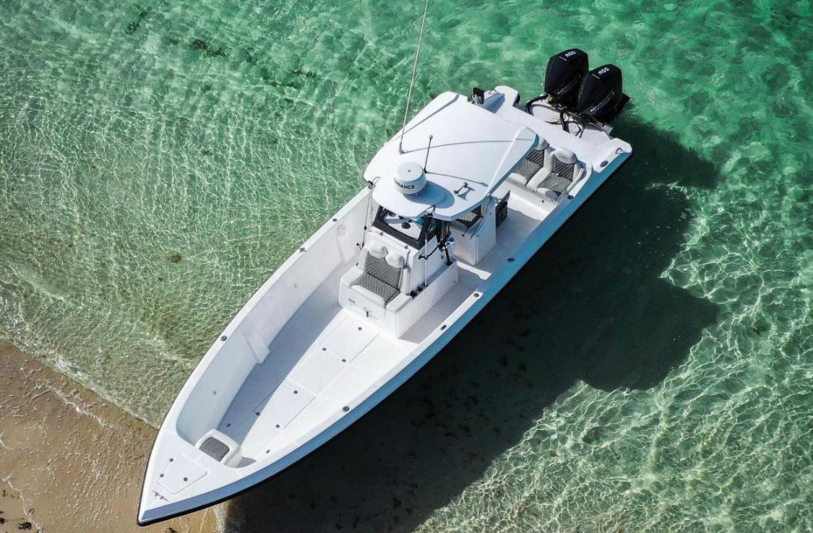
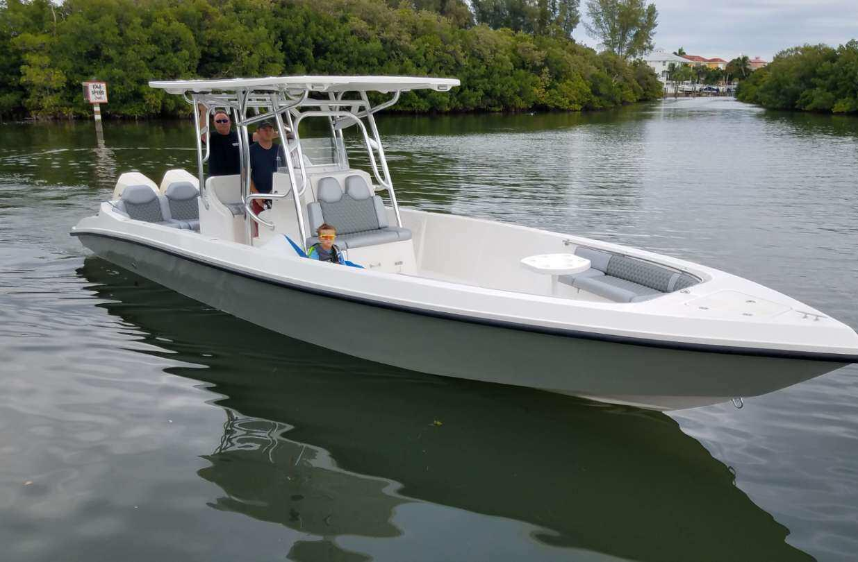
33 Feet Boat Details
➢ Length : 33 feet
➢ Beam : 10.11 feet
➢ Draft : 3.0 feet
➢ Dry Weight : 2300 kgs
➢ Fuel Tank Capacity : 900 ltrs.
➢ Water Tank Capacity : 150 ltrs.
➢ Seating Capacity : 8 persons

Slide 11
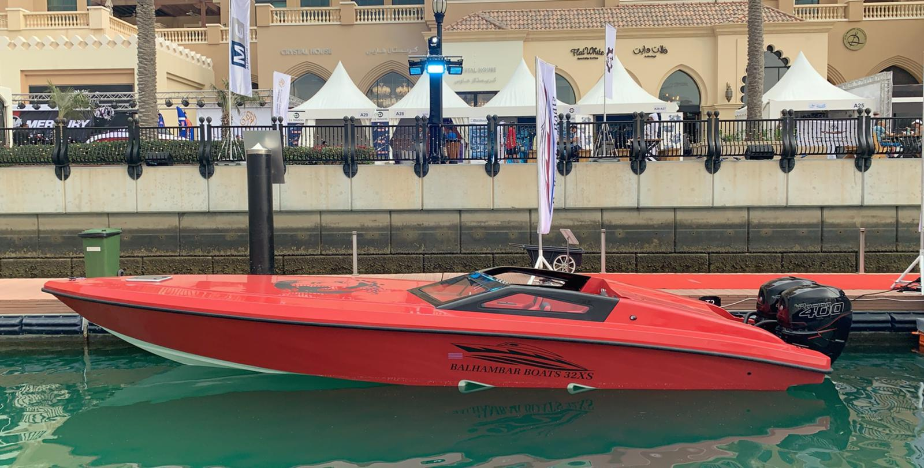
33xs Feet Boat Details
➢ Length : 33xs feet
➢ Beam : 10.11 feet
➢ Draft : 3.0 feet
➢ Dry Weight : 2200 kgs
➢ Fuel Tank Capacity : 1000 ltrs.
➢ Water Tank Capacity : 150 ltrs.
➢ Seating Capacity : 5 persons

Slide 12
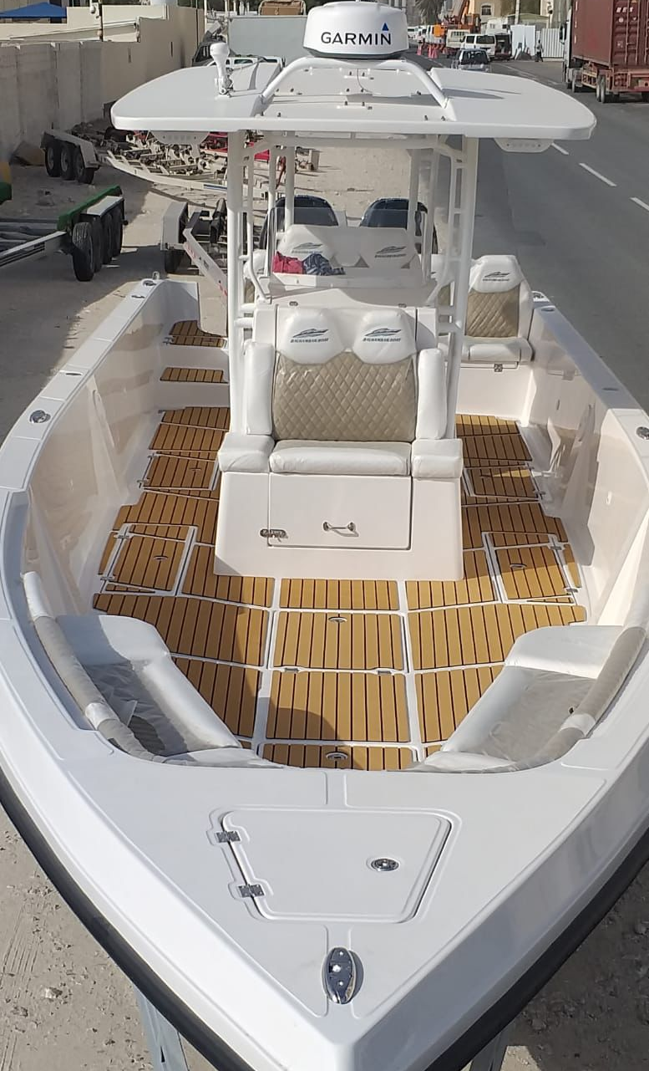
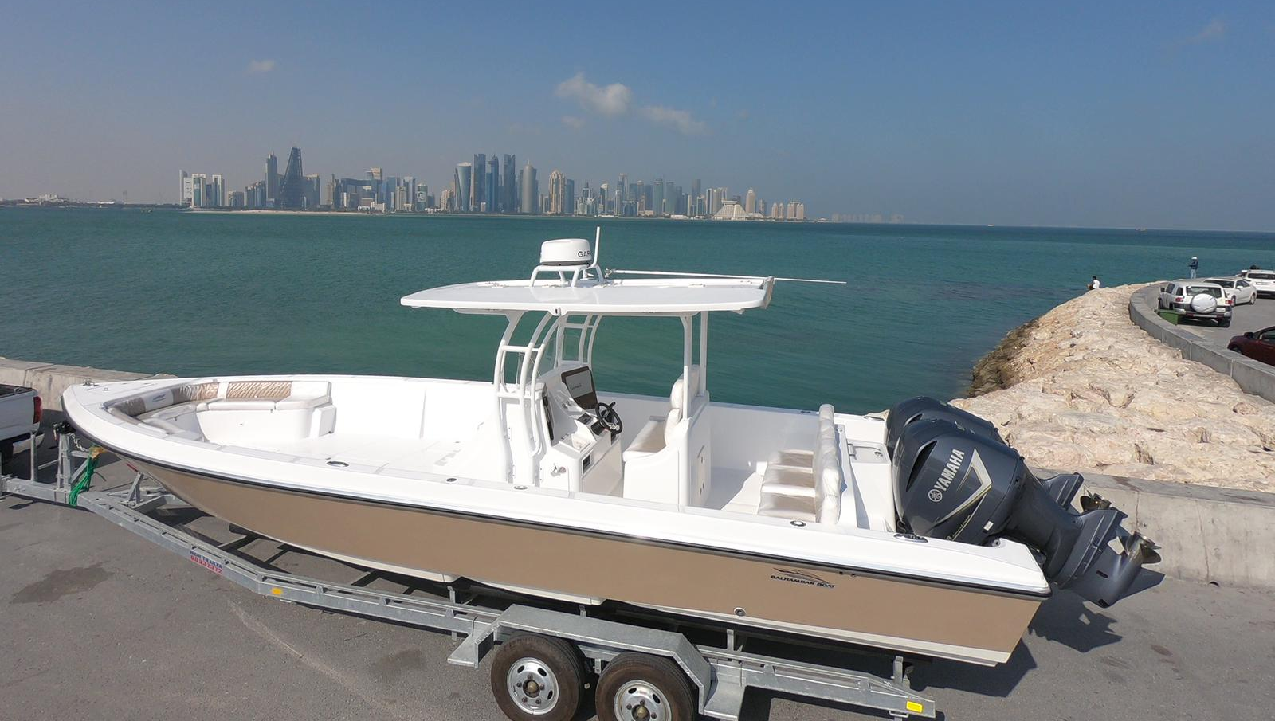
36 Feet Boat Details
➢ Length : 36 feet
➢ Beam : 10.41 feet
➢ Draft : 3.0 feet
➢ Dry Weight : 2500kgs
➢ Fuel Tank Capacity : 900 ltrs.
➢ Water Tank Capacity : 150 ltrs.
➢ Seating Capacity : 10 persons

Slide 13
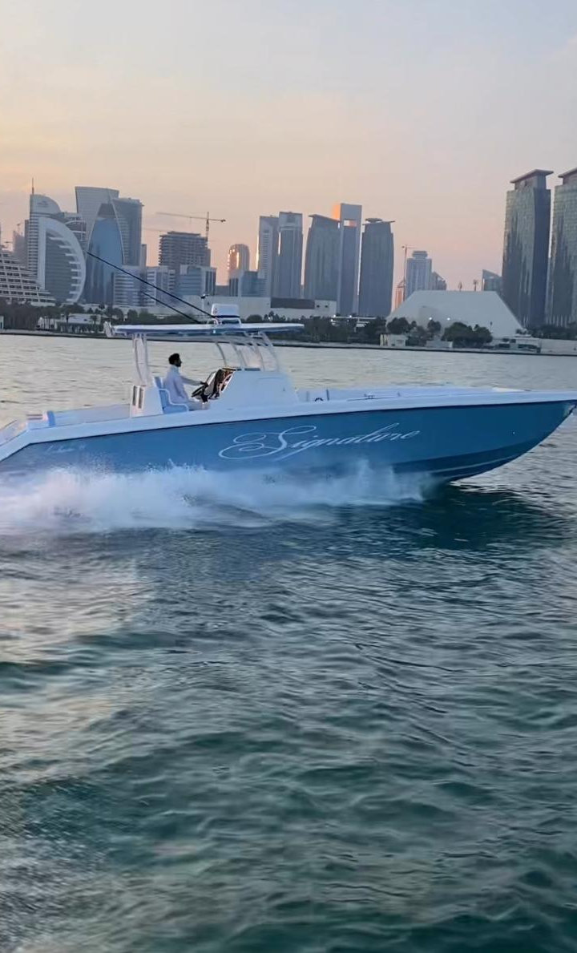
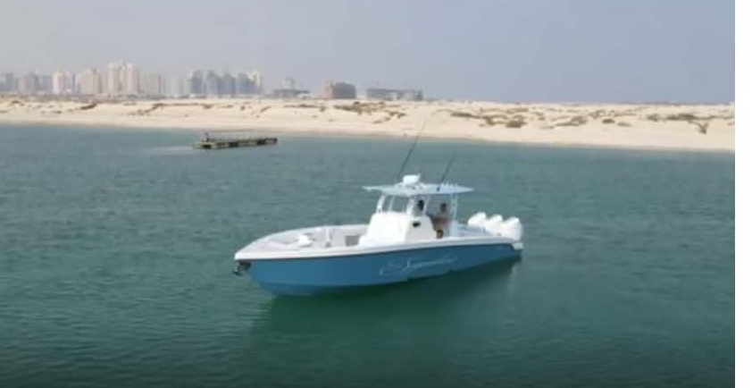
38 Feet Boat Details
➢ Length : 38 feet
➢ Beam : 11.0 feet
➢ Draft : 3.0 feet
➢ Dry Weight : 4000kgs
➢ Fuel Tank Capacity : 1500 ltrs.
➢ Water Tank Capacity : 150 ltrs.
➢ Seating Capacity : 12 persons

Slide 14
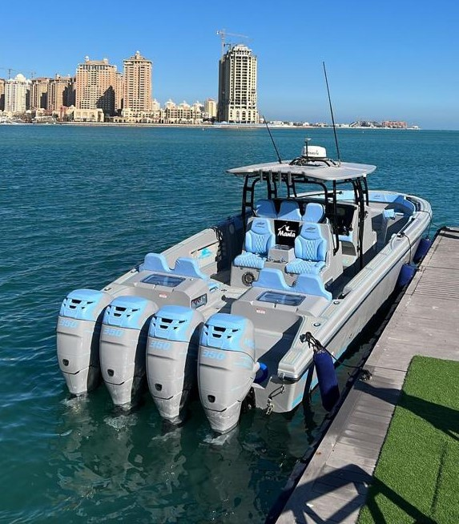
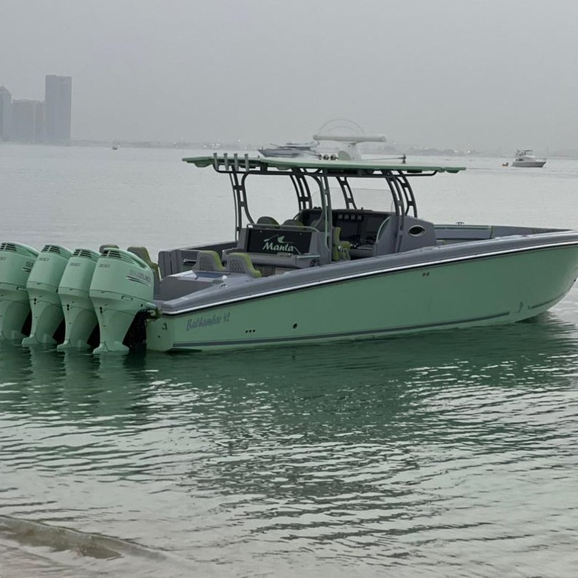
42 Feet Boat Details
➢ Length : 42 feet
➢ Beam : 13.0 feet
➢ Draft : 3.0 feet
➢ Dry Weight : 6000 kgs
➢ Fuel Tank Capacity : 2000 ltrs.
➢ Water Tank Capacity : 200 ltrs.
➢ Seating Capacity : 10 persons

Slide 15
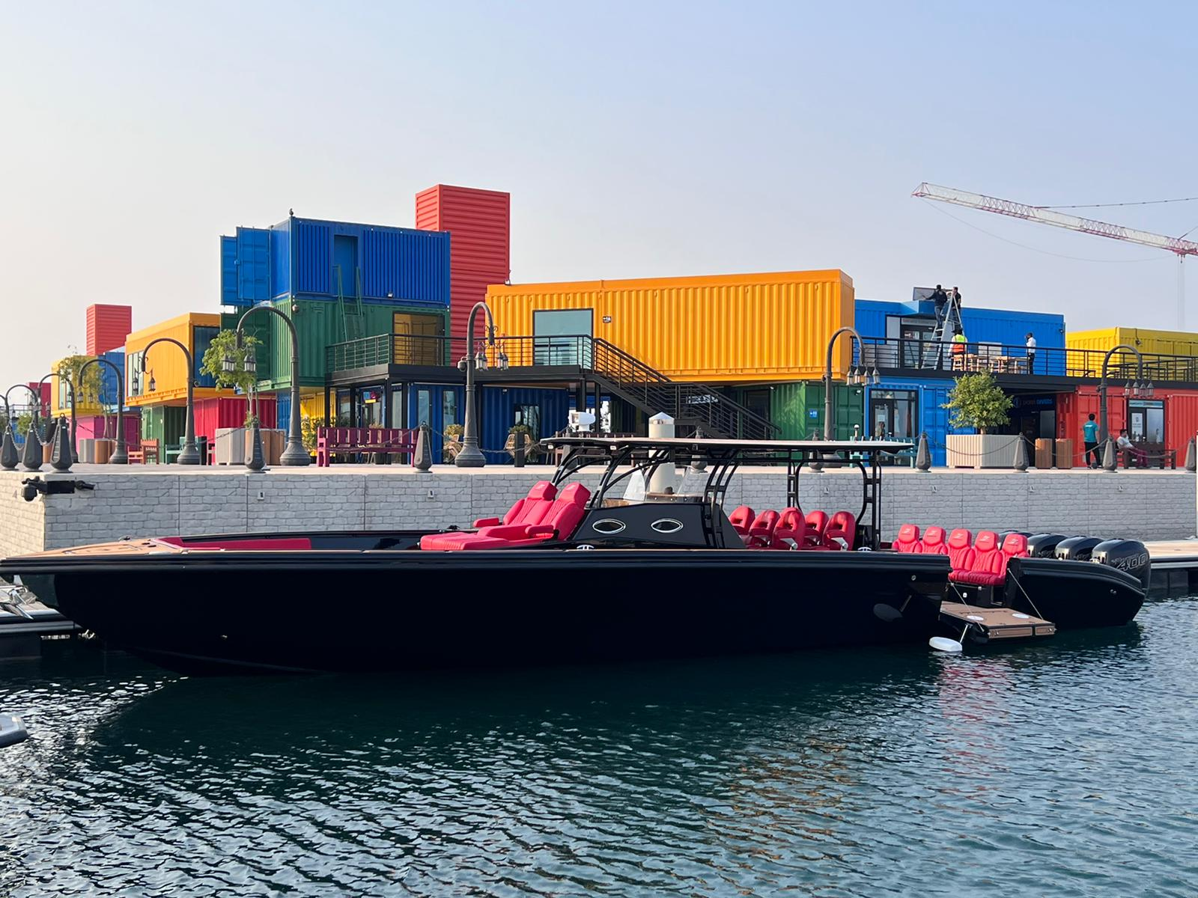
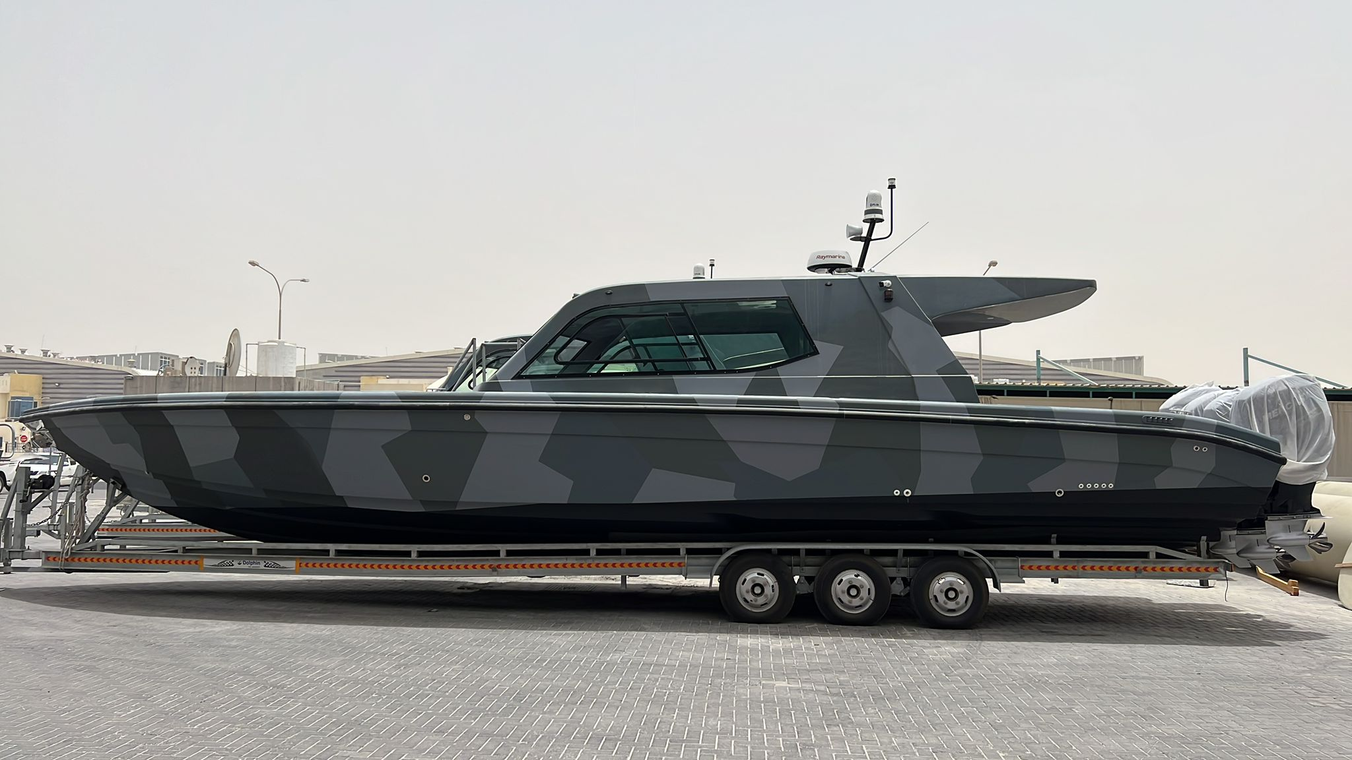
46 Feet Boat Details
➢Length : 46 feet
➢ Beam : 13.0 feet
➢ Draft : 3.0 feet
➢ Dry Weight : 7000 kgs
➢ Fuel Tank Capacity : 2000 ltrs.
➢ Water Tank Capacity : 250 ltrs.
➢ Seating Capacity : 13 persons

Slide 16
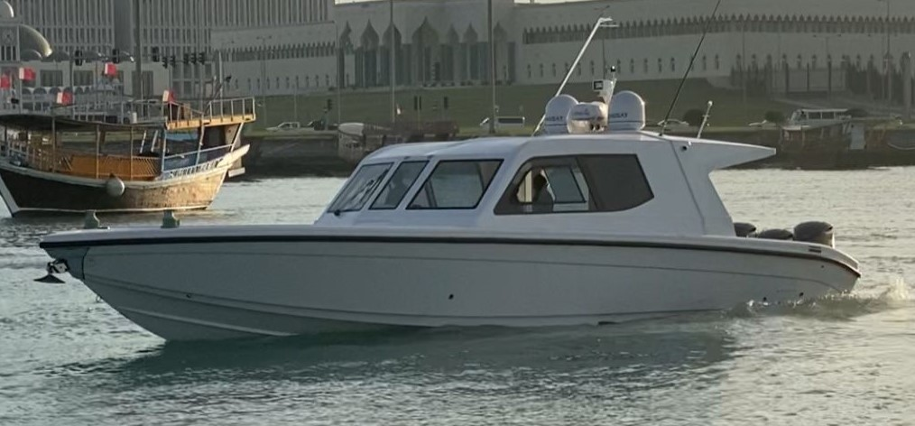
48 Feet Boat Details
➢ Length : 48 feet
➢ Beam : 13.0 feet
➢ Draft : 3.0 feet
➢ Dry Weight : 9000 kgs
➢ Fuel Tank Capacity : 2000 ltrs.
➢ Water Tank Capacity : 300 ltrs.
➢ Seating Capacity : 13 persons

Slide 17
List of our customers
➢ Amiri Guard
➢ Amiri Yacht’s
➢ Coast Guard
➢ Qatar Navy
➢ Joint Special Force
➢ Katara Valley of Cultures
➢ Ministry of Municipality & Environment
➢ KSA –Saudi Arabia
➢ Oman
➢ UAE
➢ Kuwait
➢ Malta
➢ USA
BALHAMBAR BOATS
One of biggest and best trendsetting boat manufacturer

Slide 18

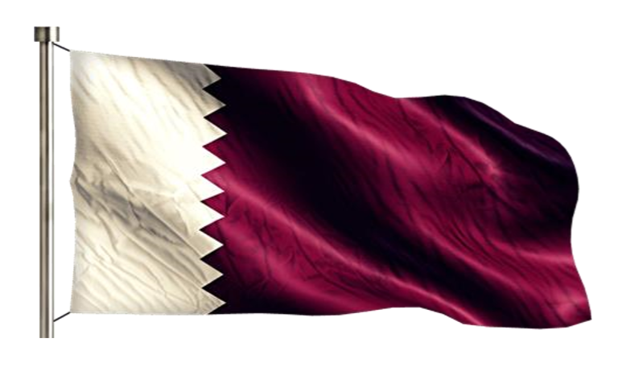








BALHAMBAR BOATS FACTORY
One of biggest and best trendsetting boat manufacturer
For inquiry and questions, call or send to the address below:
Yousef Jasssim Al-Khulaifi
+974 4441 1019
+ 974 5553 5568
+974 4441 1018
info@balhambar.com
www.balhambar.com
https://www.instagram.com/balhambarboat/
https://www.facebook.com/Balhambarboat
https://wa.me/97466949473

